Slide 1

Quick Note
Speaker: Yichen PAN (Eason)

Slide 2
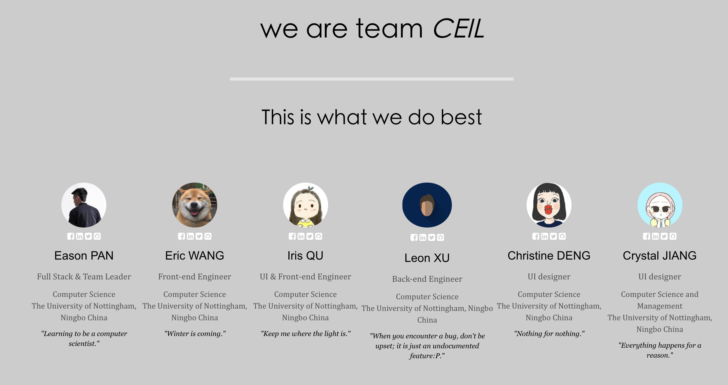
00
Our Team: http://quicknote.cc
1
2
6
3
5
4
Notes:
First of all, this is the whole development team of Quick Note, and they are all here right now.
Our team is called CEIL. It is the combination of initial characters of English names of group members. It is also a very classical and meaningful function name in computer science.

Slide 3
Overview
Special features
Practice
Research
Conclusion

Slide 4
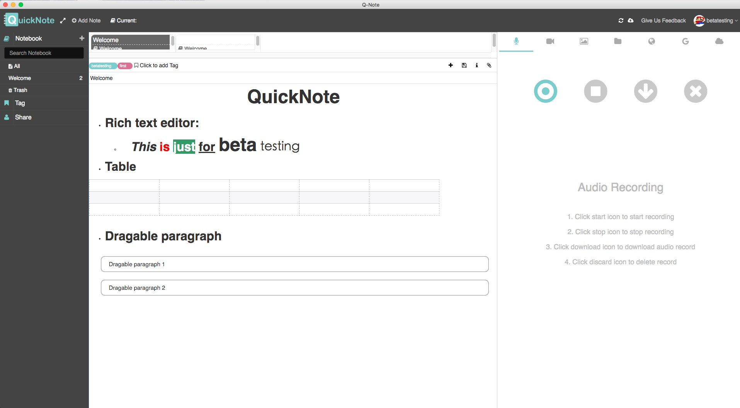
00
Basic: Rich Text
1
2
6
3
5
4
Notes:
The application distinguishes from the common note-taking application from two sides. The first is its practical and powerful functionalities. Apart from the basic functionalities shared by most common note-taking applications, such as rich text editing, note and notebook classification and tagging

Slide 5
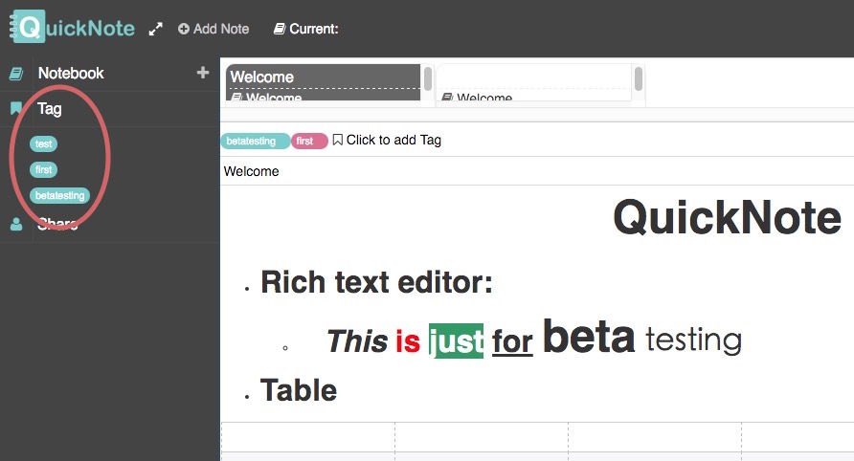
00
Basic: Tagging
1
2
6
3
5
4
Notes:
The application distinguishes from the common note-taking application from two sides. The first is its practical and powerful functionalities. Apart from the basic functionalities shared by most common note-taking applications, such as rich text editing, note and notebook classification and tagging

Slide 6
Special Features
Practice
Multi-media
Drag & Drop
Cloud Storage
Audio & Video
Sharing
Online Synchronization & Offline Using
Cross Platform
Research (Tracking)
Notes:
it provides a number of distinct features, including Multimedia、Drag & Drop、cloud storage、audio and video recording、share、Online synchronized and offline used、 Cross-platform and etc.

Slide 7
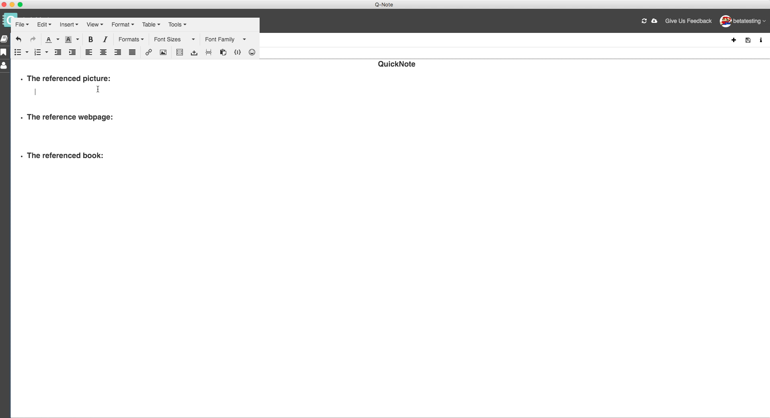
01
Multi-Media
1
2
6
3
5
4
Notes:
One special feature of our application is that it could insert videos, images, pdfs or even web pages into the note directly, which is one feature that no other note-taking apps has realized so far. The videos and audios could be played inside the note. The webpage could also be manipulated within the app.
Another spot light is that pdf, images, videos and audios could be opened inside the app and there is an embedded web browser, which supports the multi-tasking of the user. For example, when a student is taking notes, he may need to open several files for reference, watching a tutorial video or even searching for information on the internet.

Slide 8
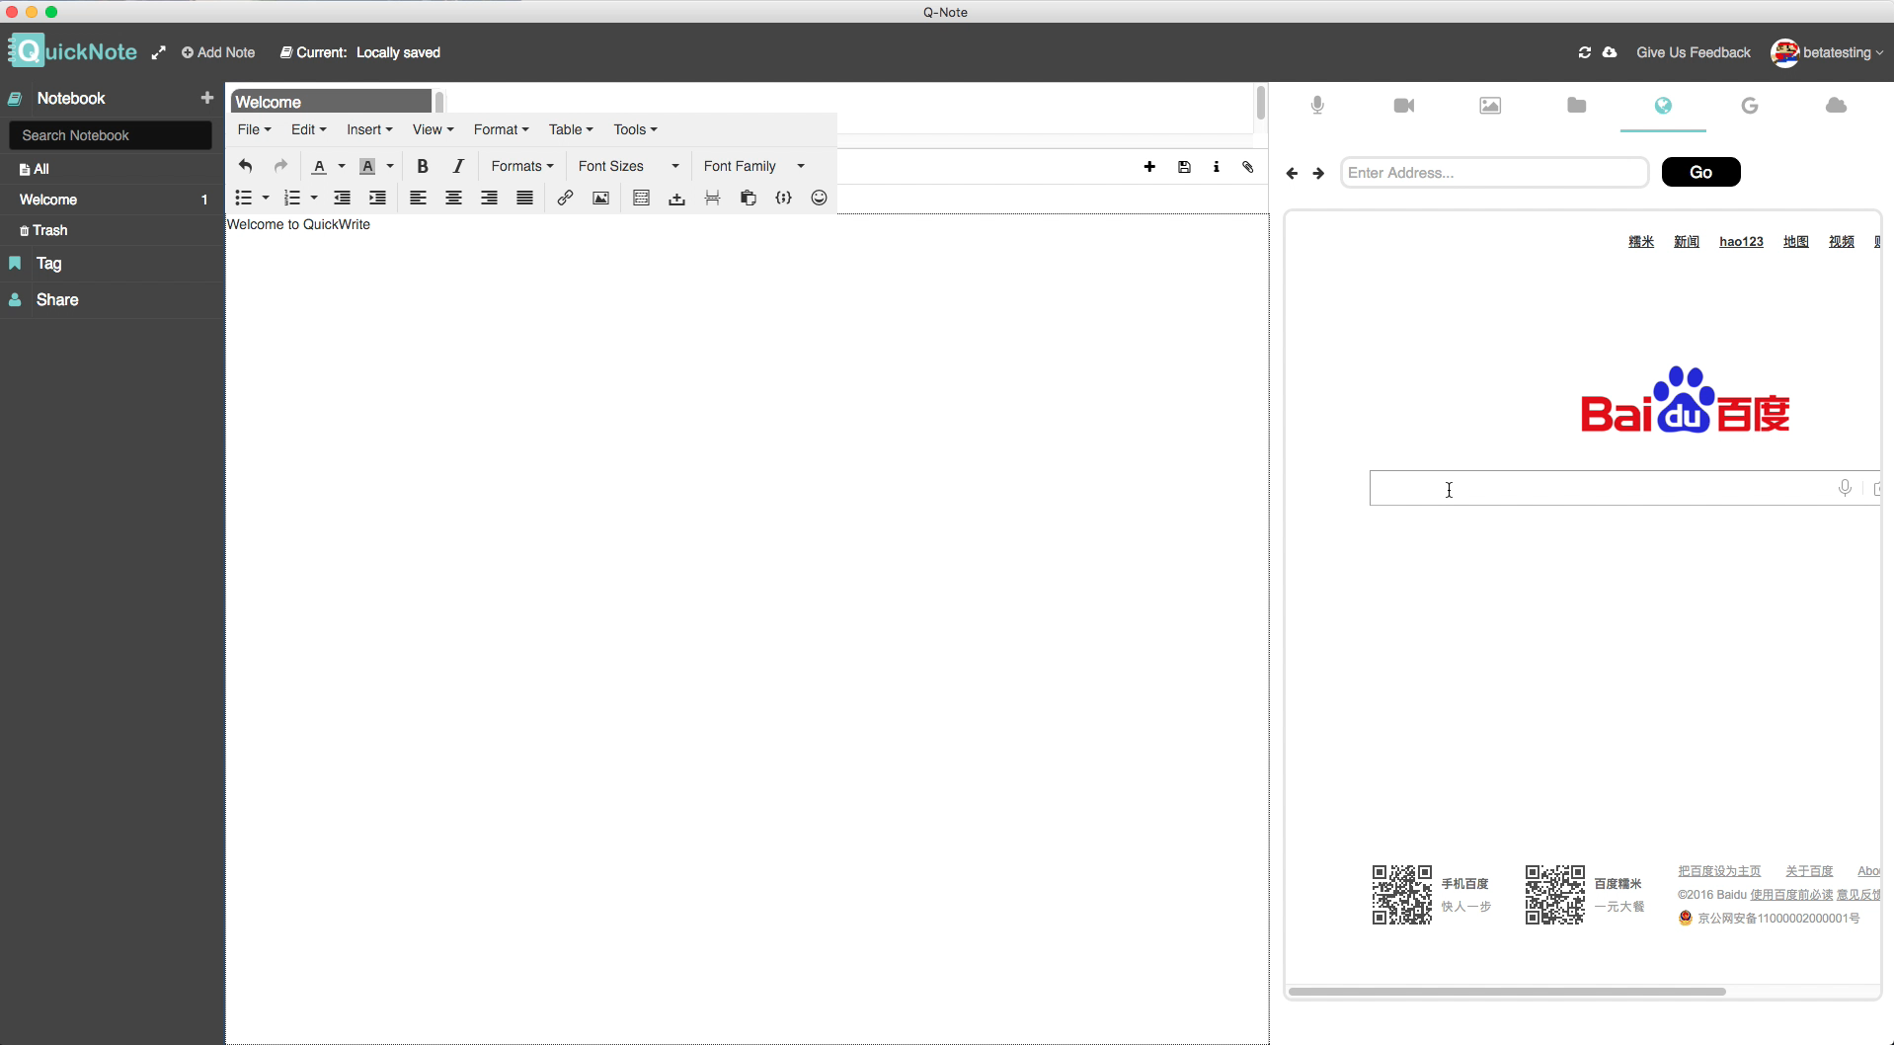
02
Drag & Drop
1
2
6
3
5
4
Notes:
The second amazing feature is that we could drag and drop any dragable elements, such as pictures, links from the embedded web browsers into our notes. The links for them will be saved automatically, which is very convenient for reference later. The link could also be opened in the embedded web browser.

Slide 9
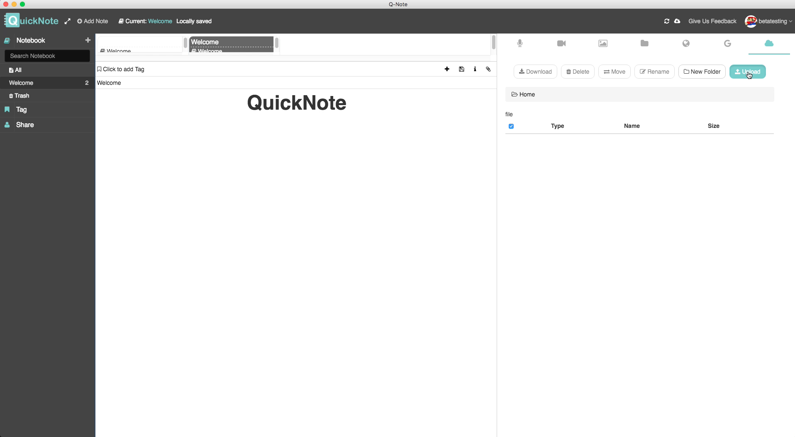
03
Cloud Storage
1
2
6
3
5
4
Notes:
The app supports cloud storage, which means every user has their own cloud space to store any file within the note. The app provides a clear and straight interface for the user to categorize and manage their files on their own will. As you can see, this interface is just like a simple but powerful file system. It also allows the user to insert the stored files into the note directly, which makes it much easier for the user to take notes.

Slide 10
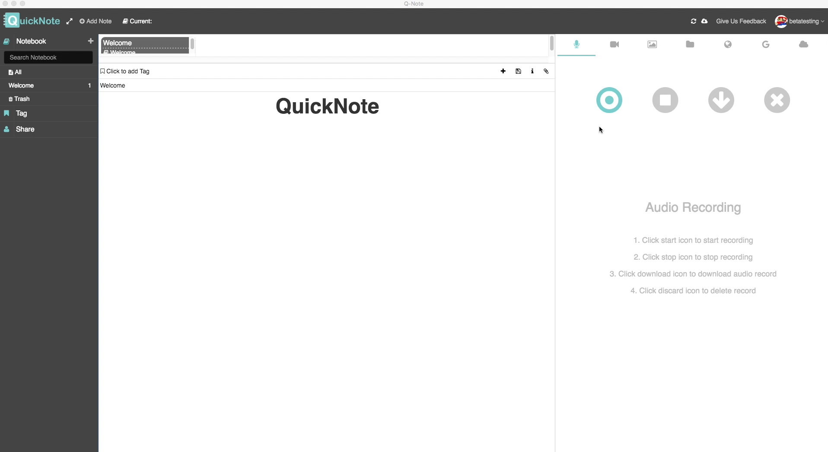
04
Audio & Video
1
2
6
3
5
4
Notes:
The app allows the user to do audio and video recording and could help upload these recorded files to the cloud storage directly. This functionality could improve the efficiency of students in lessons significantly. It also allows students to take pictures using the webcam of the computer. This is really useful in practice because we find that students in UNNC always want to take picture of what is written on the blackboard so that they could save time in class and research on them later after class.

Slide 11
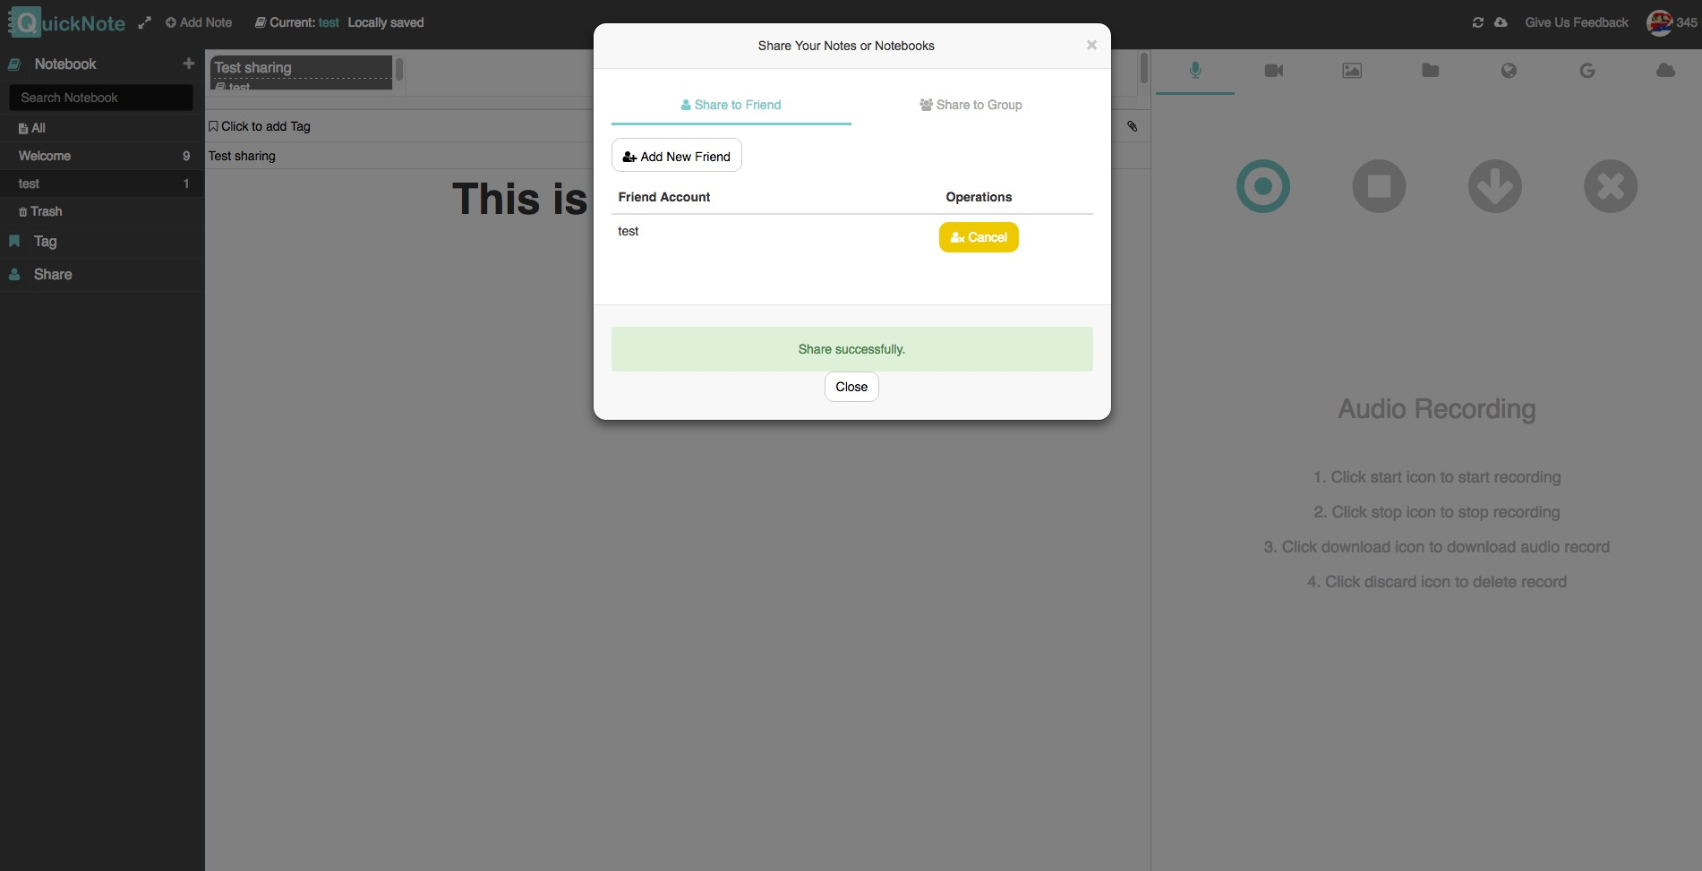
05
Share
1
2
6
3
5
4
Notes:
Notes or the whole notebooks could be shared among users so that it is very convenient for students to exchange ideas about modules or lectures, which would do a lot to the learning process of students in UNNC.

Slide 12
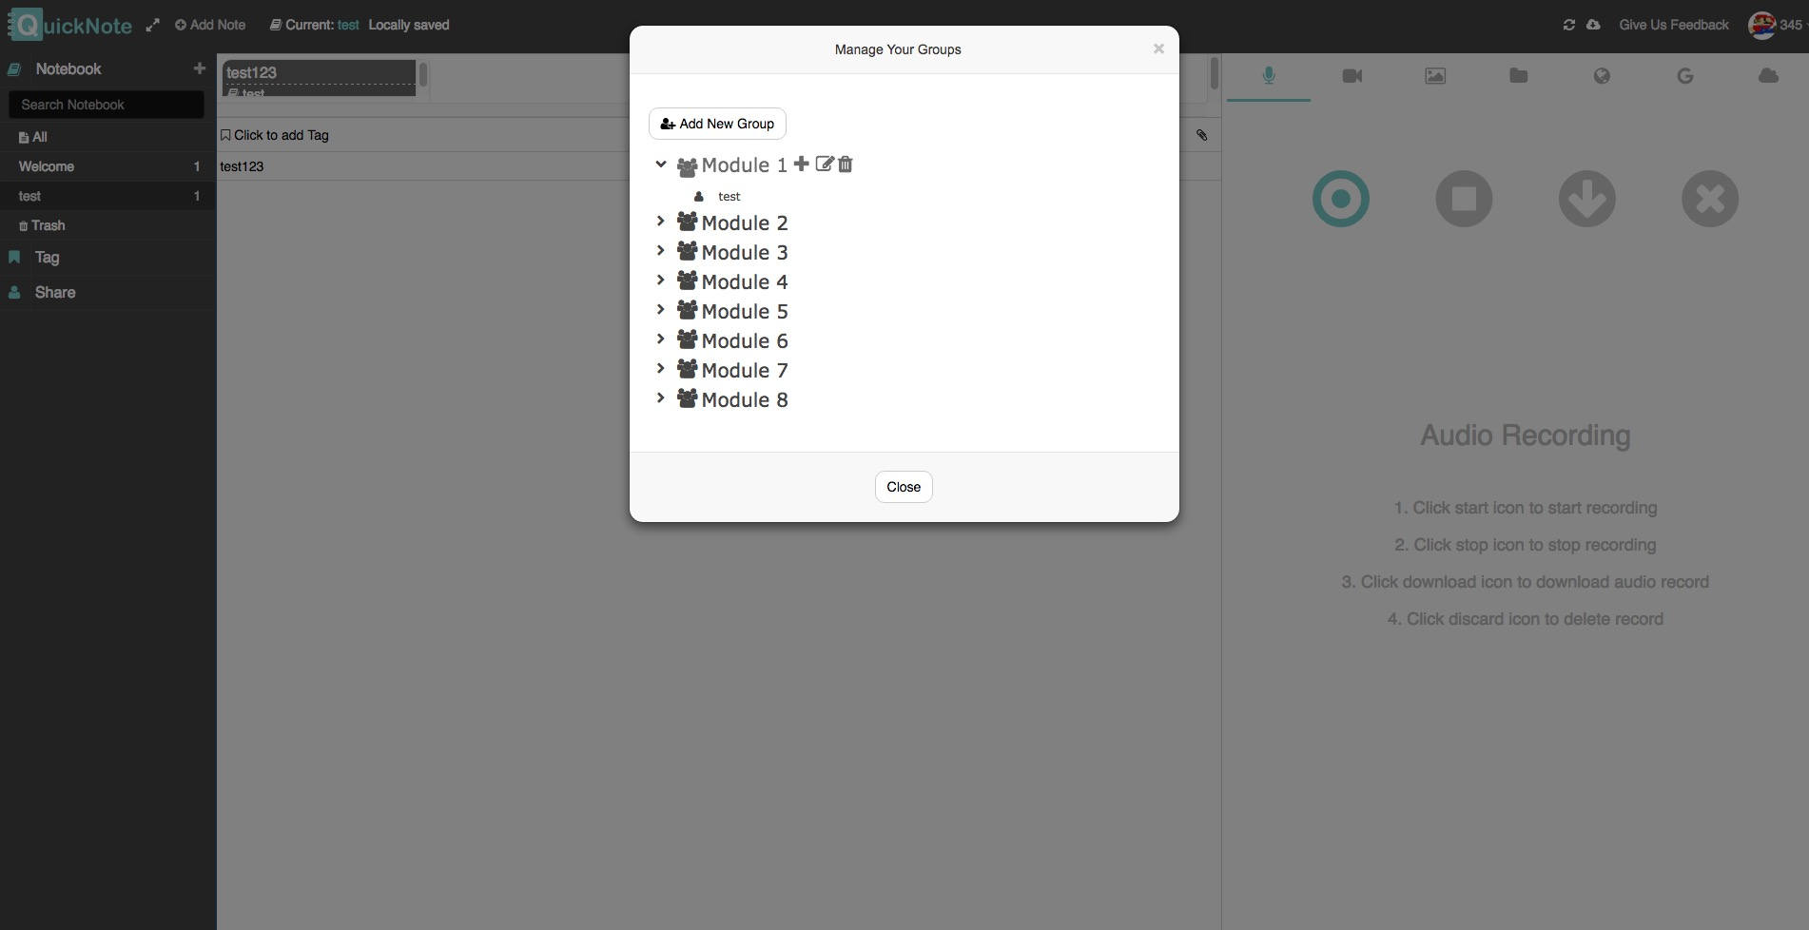
05
Share
1
2
6
3
5
4
Notes:
As you can see here, it allows the user to create and manage their own group so that the sharing could be done on the group level. For example, the user could create a group called module 1 and add all students taking this module into this group

Slide 13
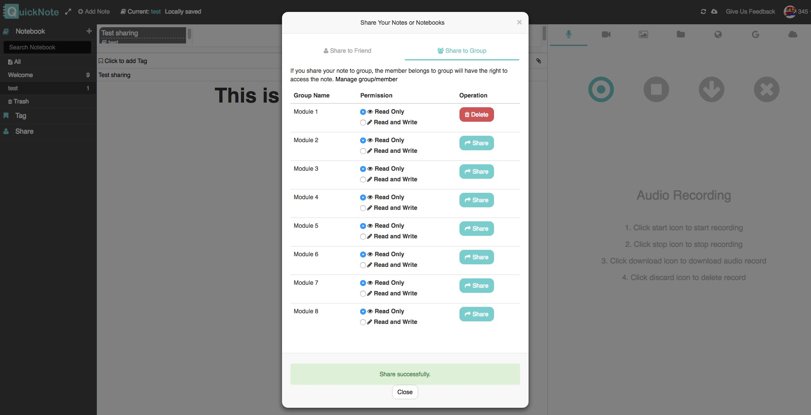
05
Share
1
2
6
3
5
4
Notes:
so that he just needs to share the note or the notebook one time to this group, all users under this group could receive the shared note or the notebook.
Additionally, since we have a database and tag classification function, the combination of these two would help build a module or lecture-specific notes database. And I think it is particularly useful since if notes are public, we can gather thousands of notes about a specified lecture or topic in one second.

Slide 14
06
Online & Offline
Online synchronization automatically
Offline saving automatically
1
2
6
3
5
4
Notes:
The app supports online synchronization and offline use. This mechanism will enable students to take notes without the internet. All the notes will be saved automatically and updated to the server next time with the internet connected. Moreover, notes can be retrieved from anywhere at any time as long as there is internet connection.

Slide 15
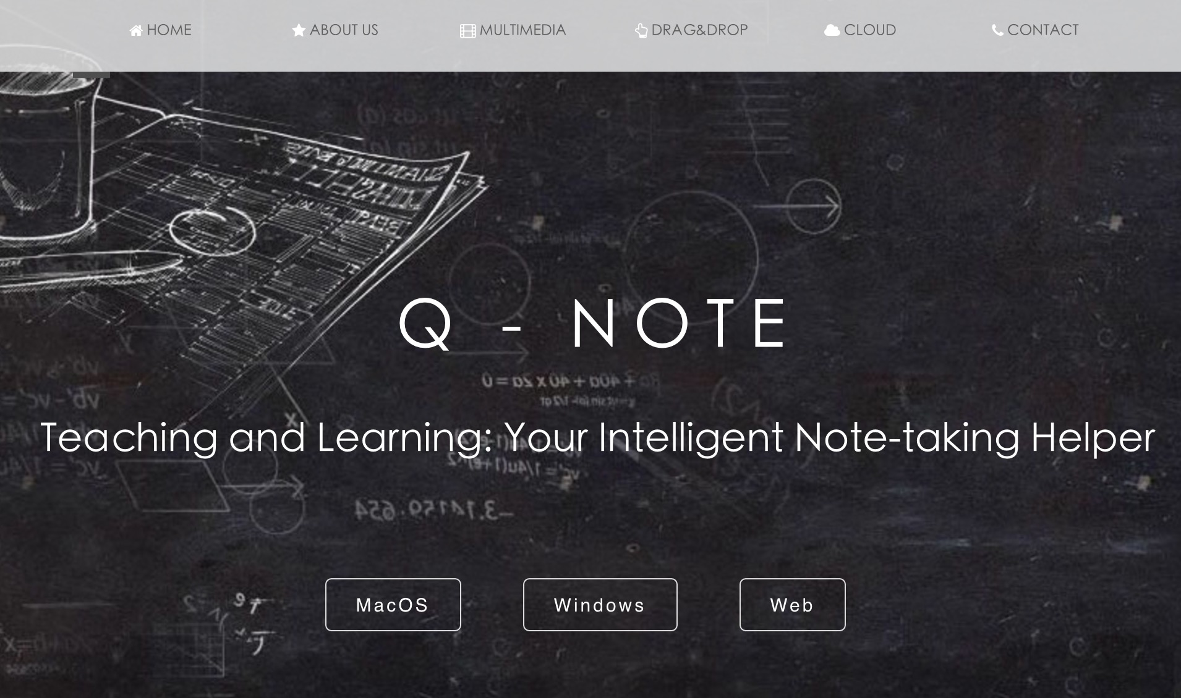
07
Cross Platform
1
2
6
3
5
4
Notes:
We made our Quick-Note run on both Mac OS and Windows (7 & 10) as native desktop apps. Additionally, we also provided a web version which is running on school Linux server right now. Anyone could use our application in the web browser as long as there is internet.
The interfaces remain consistent among different platform so that the user wont get confused.

Slide 16
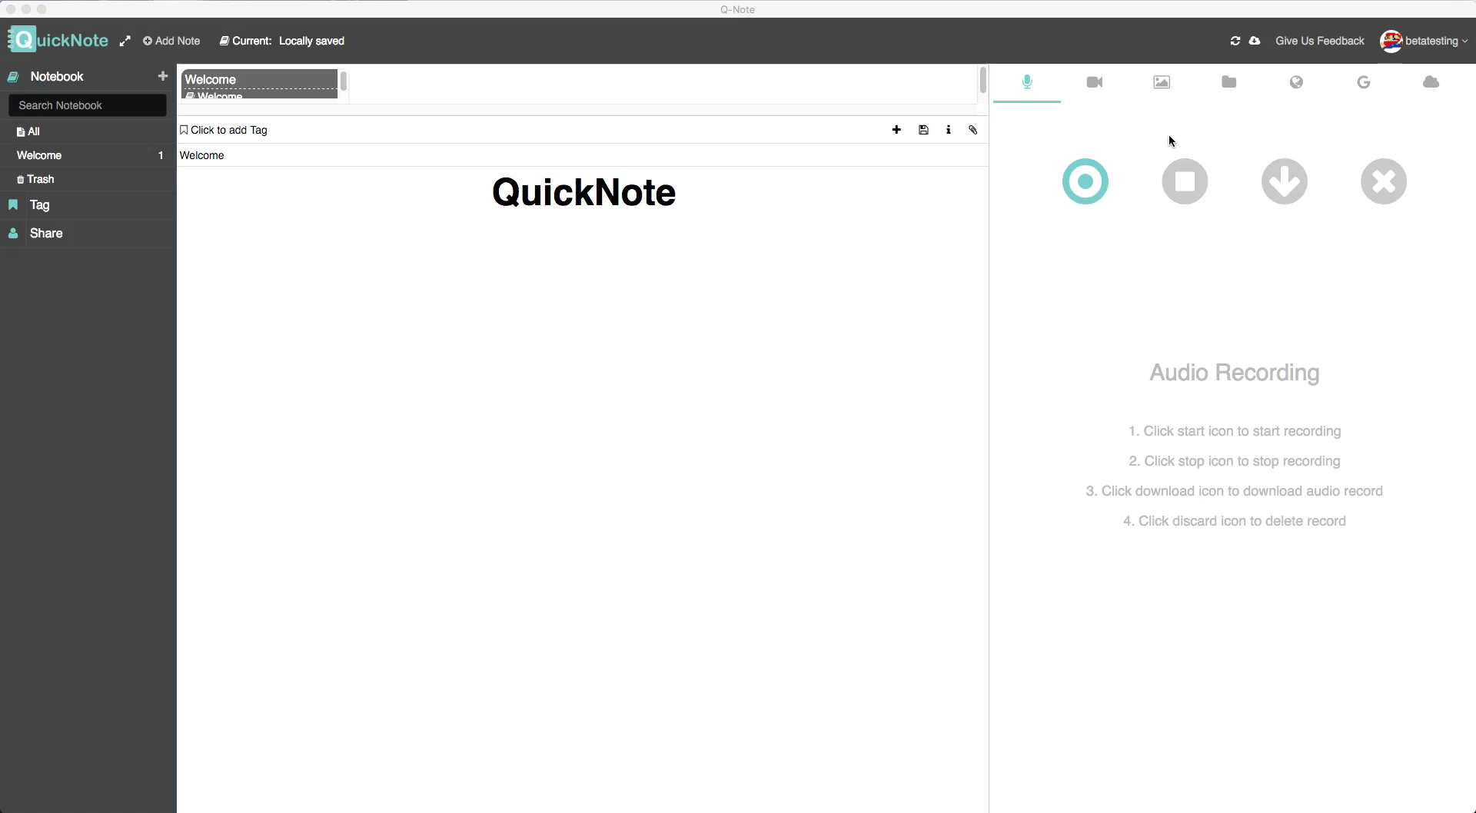
08
Tracking Activity
1
2
6
3
5
4
Notes:
The other aspect that distinguishes our application is its research usage. The application could track activities of the user under the permission, such as the web surfing history, multimedia usage and etc. These metadata could be automatically collected within the app as excel file so that the researcher could investigate on them for any research purpose.

Slide 17
Conclusion
Alpha Testing ✔
Beta Testing ....
Notes:
Currently, the application is running on the university server which is partially maintained by IT service, so anyone in the campus could use it. Moreover, it has gone through a complete alpha testing, which means it is ready to be used by a large group of users. However, it is still under the beta testing, indicating it may still not be stable when it is being used widely. So here is the URL of our QuickNote, anyone interested are extremely welcome to have a try on it and give us any suggestion you could think of. We really appreciate your help and ideas.

Slide 18
www.quicknote.cc

